Slide 1
Power factor correction of induction motor
Large kVA necessitates the installation of larger power plant i.e. generators and associated apparatus (e.g. transformers) and copper of larger cross-sectional area for transmission of power .
The reactive current also gives rise to additional losses in the copper and voltage drops.

Slide 2
For these reasons Utility companies design their rate structure (tariff) in such a way that billing will automatically increase whenever the power factor of a consumer is low.
The full-load power factor of an induction motor rarely exceeds 0.9 (it is worse when motor is under rated), and it may pay to raise the power factor.

Slide 3
Power factor correction of
induction motor cont’d
Capacitors may be employed for that.
The capacitor may be connected
  directly across the stator terminals or
  indirectly through control equipment
as shown on the next slide

Slide 4
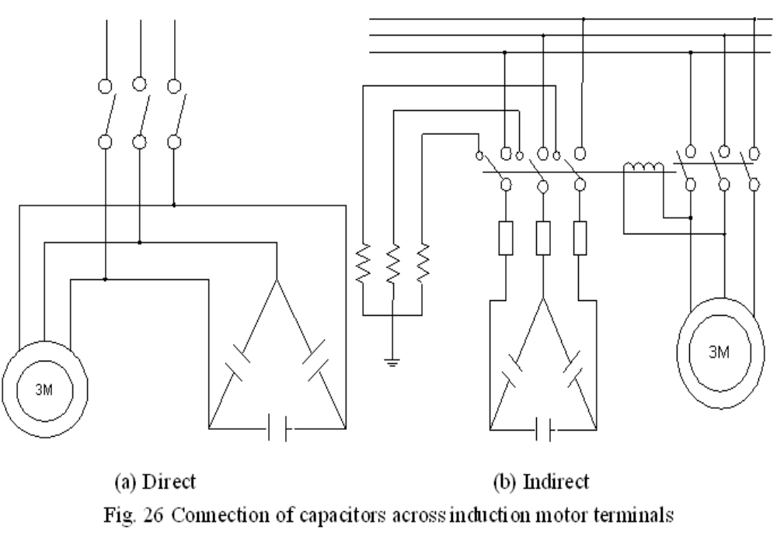

Slide 5
The direct connection which is common because it is practical and economical requires caution to avoid the possibility of momentary self excitation of the motor as an induction generator.
If the capacitor rating is too high damage may result to both motor and capacitor, because the motor, while still revolving after disconnection from the supply may act as a generator by self-excitation to produce a voltage higher than the supply voltage.

Slide 6
Power factor correction of
induction motor cont’d
If the motor is switched on again before the speed has fallen to about 80% of the normal running speed, the high voltage will again be superimposed on the supply voltage and there may be a risk for damage for other types of equipment.

Slide 7
Power factor correction of induction
motor cont’d
The capacitance may have to be limited to a value that makes self excitation impossible.
As a general rule, the correct size of capacitor for individual correction of motor should have a kVar rating not exceeding 90 % of the no-load magnetizing kVA of the machine.

Slide 8
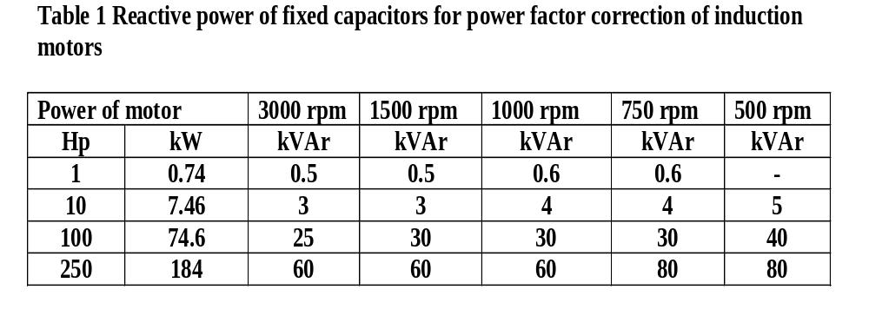
Power factor correction of induction
motor cont’d
In practice, power factor correction should not be pushed beyond limits shown in Table 1.

Slide 9
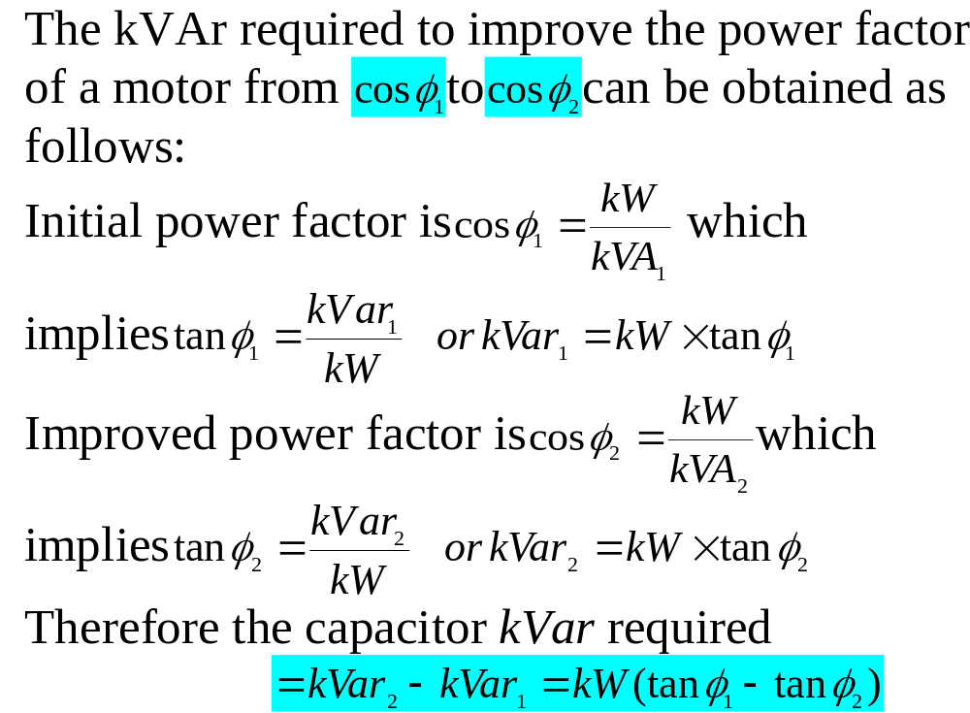

Slide 10
Power factor correction of induction
motor cont’d
Where star-delta starting is used, a standard three-terminal delta-connected capacitor as shown on the next slide should be employed.
This gives maximum power factor correction at the start when the power factor of the motor is low.

Slide 11
